Slide 1


MICROSOFT COPILOT AND OUTLOOK

Slide 2
COPILOT IN OUTLOOK CAPABILITIES

Slide 3

Module Agenda
Copilot capabilities in Outlook
Write Everyday Emails with CoPilot
Write Creative Emails with CoPilot
Reply to Emails using CoPilot
Draft Email Summaries with CoPilot
Email Coaching by CoPilot
© All rights reserved for Dr. Ryan Ahmed @Stemplicity Inc.

Slide 4
CoPilot Capabilities in Outlook
Write Everyday Emails with CoPilot: CoPilot helps craft clear, professional, and concise emails for everyday communication.
Write Creative Emails with CoPilot: CoPilot generates innovative and engaging email drafts tailored to specific audiences or purposes.
Reply to Emails using CoPilot: CoPilot drafts quick, appropriate, and context-aware email replies, saving time.
Draft Email Summaries with CoPilot: CoPilot creates succinct summaries of lengthy email threads for easy understanding and action.
Email Coaching by CoPilot: CoPilot provides tips and suggestions to improve email tone, structure, and professionalism.
© All rights reserved for Dr. Ryan Ahmed @Stemplicity Inc.

Slide 5
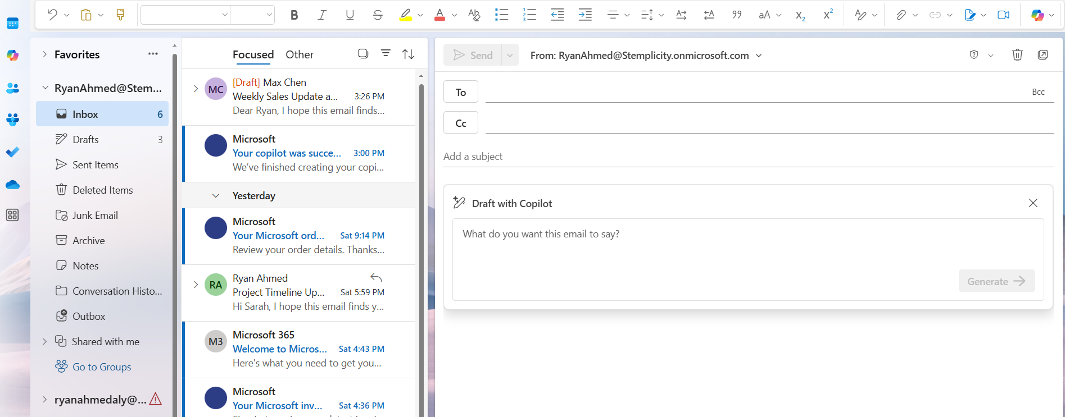
CoPilot Capabilities in Outlook
© All rights reserved for Dr. Ryan Ahmed @Stemplicity Inc.

Slide 6
LIVE DEMO

Slide 7
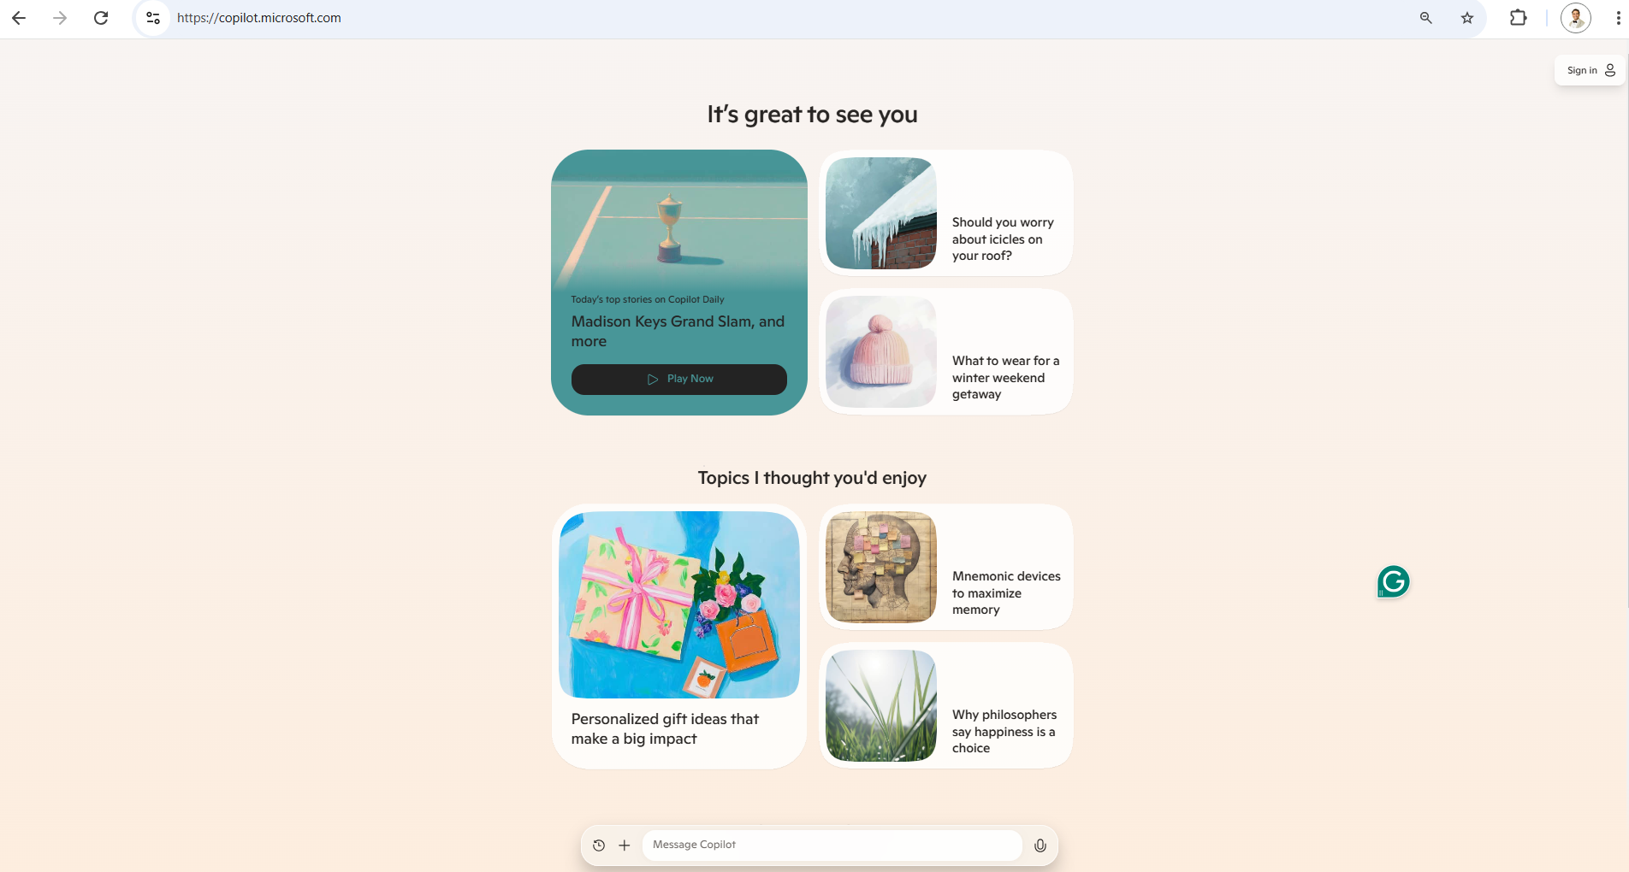
Live Demo
🔗 Click here to explore CoPilot CoPilot Signup
💡 Click here for AI Prompts Explore Prompts
© All rights reserved for Dr. Ryan Ahmed @Stemplicity Inc.

Slide 8
Thank you!

